Slide 1

Automation of offer letter generation

Slide 2
Team Members:
Jyothi J S
Shakthi Ramani
Anyatha K

Slide 3
Introduction
The project is developed to assist organisations to automate a section of their hiring process.
This is done specifically done using an automation process wherein the selection of potential candidates is first completed and written to an excel sheet which will later be used to scrap and filter data.
This data is then later used to formulate and output an offer letter for each candidate which is delivered to respective candidates email address.

Slide 4
Benefits of our project :
The benefits of our automation project:
Reduce costs.
Reduce process time.
Reduce mistakes.
To reuse the software.
Improve overall performance and reliability.

Slide 5
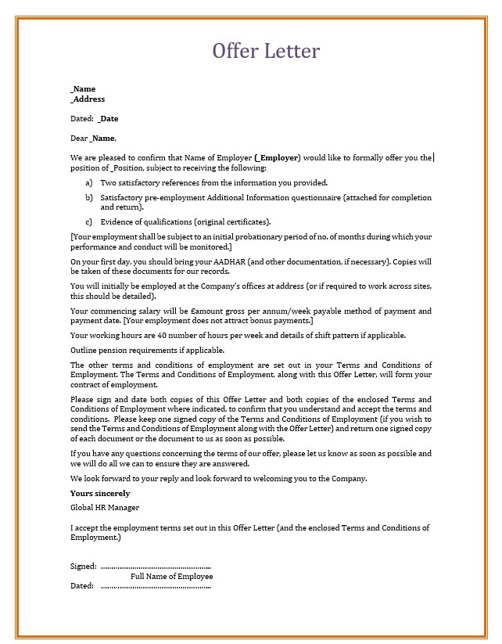
Objectives of our Project :
Automating offer letters brings benefits to all stakeholders and the company itself. They include:
For this automation project, the required information is extracted from an excel sheet and fed into the provided offer letter.
The process of feeding the required data into the template is extremely seamless and hastle-free.
Once the offer letter is generated it is saved in a PDF format in a desired location.

Slide 6
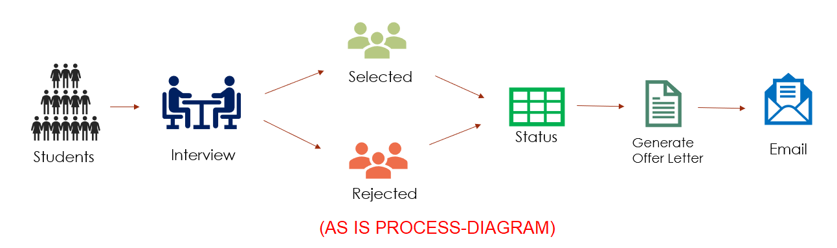
The HR Process for Generating Offer Letter : (As – is process)
Students / Candidates are Interviewed.
Some are Selected , Some are Rejected
As there are multiple Recruiters / Students - We keep track of all and maintain Status lets say in an Spreadsheet.
At the End of the Day - We have to roll our offers to the candidates Hired and send them Offer letters - This Task is Mundane and Repetitive and has scope of Automation.

Slide 7
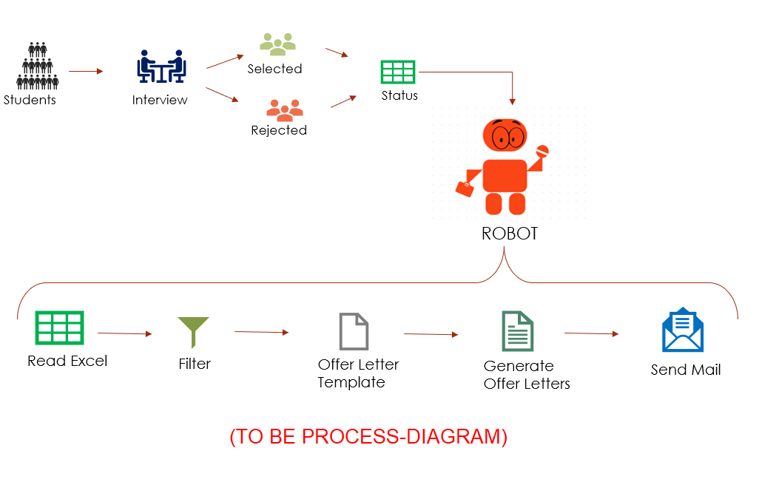
Our Project RPA Robot : (to - be process)
Robot Reads the Status Files from Shared Location.
Filter all the Hired Candidates
Generate The Offer letters as per company template
Send the Offer Letters to the Candidates.

Slide 8
COMPARISION OF SCENARIO :
SCENARIO | MANUAL PROCESS | AUTOMATED PROCESS
TIME TAKEN | Here to create one offer letter of a single candidate it would take at least 10min to 15 min, since everything is done manually | Quicker as the data is scrapped, filtered and sent by automation process, which would take just 10 to 15 minute to process 10 files
CHANCES FOR MISTAKES | High chances as it depends on employees competence level | Very low or 0
COST | High as employers will have to be paid for the worked hours | The cost involved is to create the robot. After that costs are drastically reduced compared to manual process
EFFICIENCY | Manual process lowers efficiency for bulk application | Quicker no matter the scenario
EFFECTIVENESS | Results in lower efficiency as employee have to perform same task over and over again | To replace repetitive, mundane, rule-based processes with software bots
NOVELTY AND UNIQUENESS | The results could be developed as per the employees idea resulting in varying formats | The results are always in same format. For different templates or formats, entire new program or new workflow has to be created

Slide 9
Future Enhancement :
Extract data from HR application, and generate offer letter and send it to respective Hired candidates. In this case, we can schedule this job at particular time since there no manual entry required.

Slide 10
Thank You

